Slide 1
Cloud Demo
Xuan Gao
Associate Solution Engineer Candidate, Oracle

Slide 2
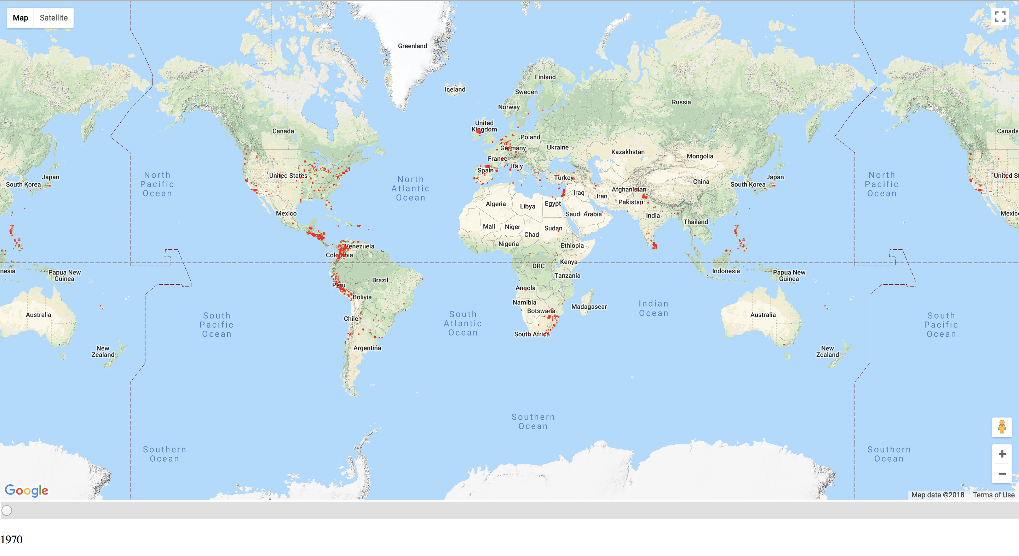
Terrorism Visualization
Notes:
We can use data visualization to solve problems. Like help government to avoid terrorism, see the changes in the world conditions. Notice people to against terrorism together and treasure the peace life.
the number of deaths in the Middle East and North Africa due to terrorist attacks has exceeded 2/3 of the number of deaths worldwide.

Slide 3
Technologies
Kaggle Dataset: Global Terrorism Database
Front-end: Google Map API
Back-end: Node.js
Database: MySQL
Notes:
Presentation tier (also known as the user interface or the client application)
Business logic tier (also known as the application server)
Data storage tier (also known as the database server)

Slide 4
Architecture
Year, Latitude, Longitude data stored at MySQL database
The database is deployed to the Oracle MySQL Cloud
Front-end code to use Google Map API
Back-end code to get data from database
The web app is deployed to the Oracle Application Cloud
Notes:
App.js 开启服务器，服务器绑定public文件夹
dbHelper.js 逻辑， 后端链接数据库
Routes.js 自己后端api
数据存在数据库，数据库存在oracle mysql cloud中
前端后端代码部署到云上

Slide 5
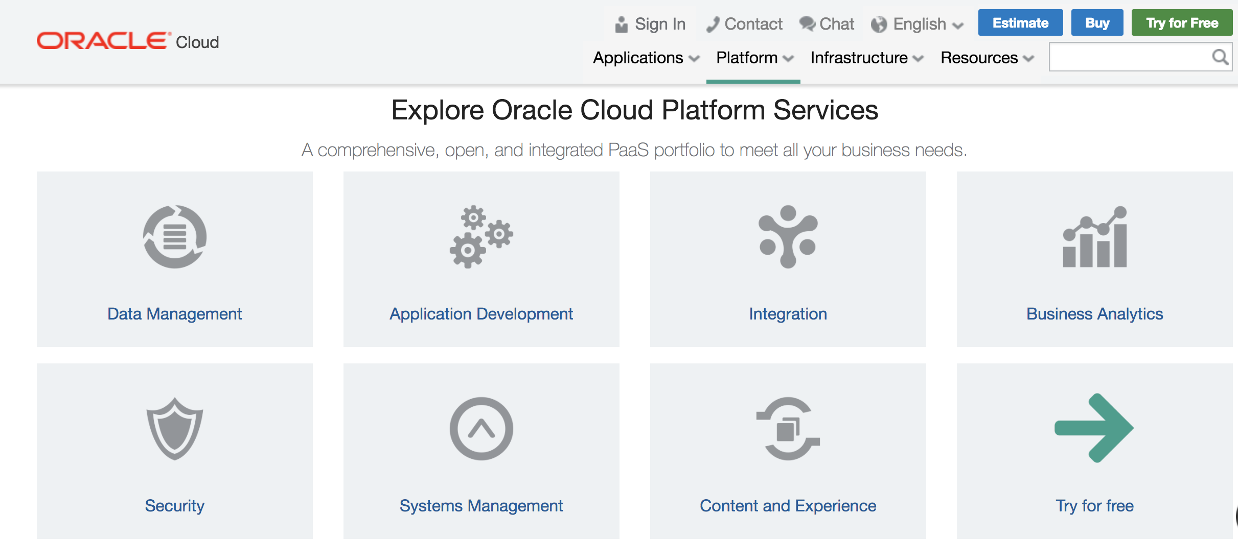
PaaS
Oracle Application Container Cloud
Oracle MySQL Cloud Service

Slide 6
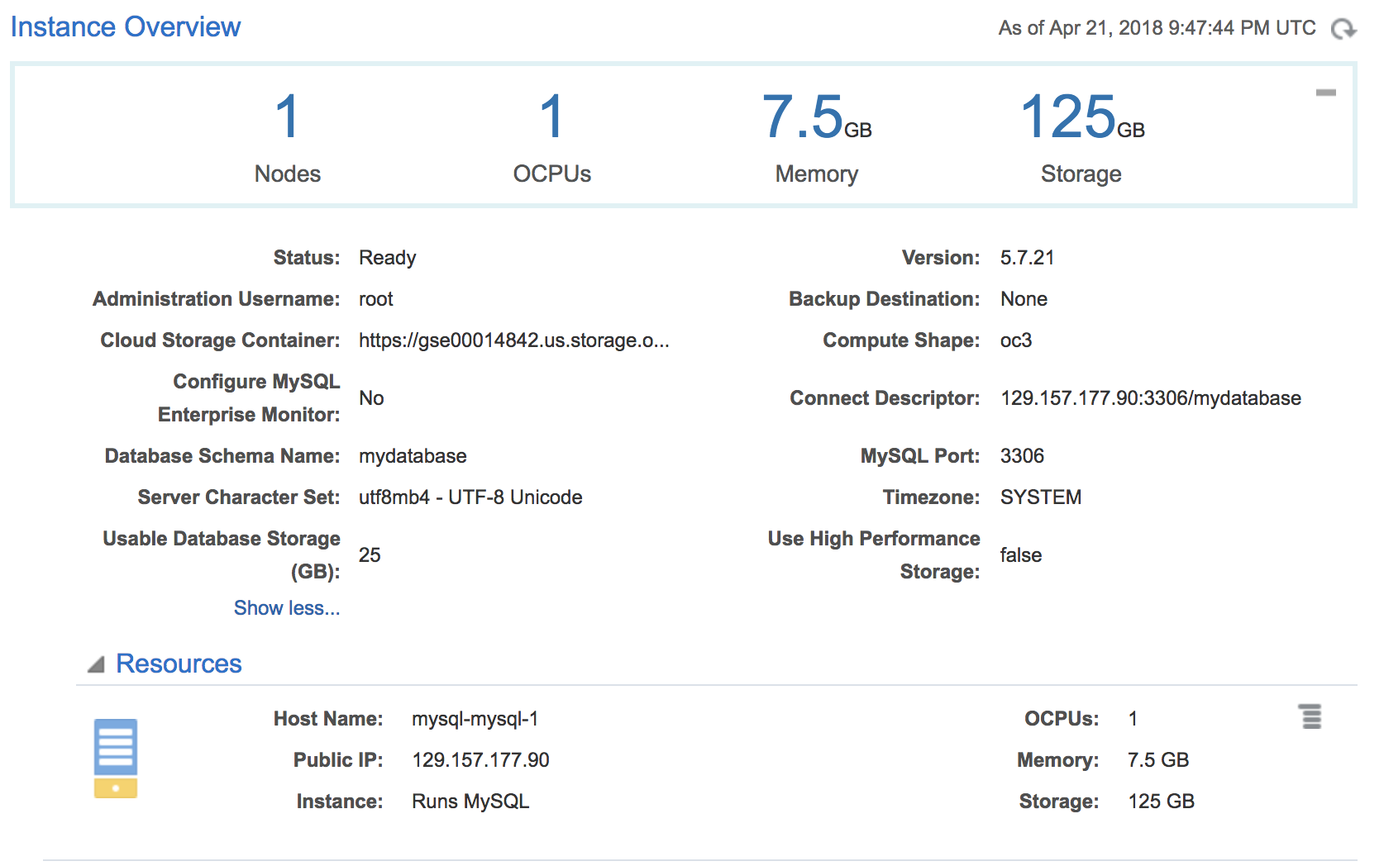
PaaS

Slide 7
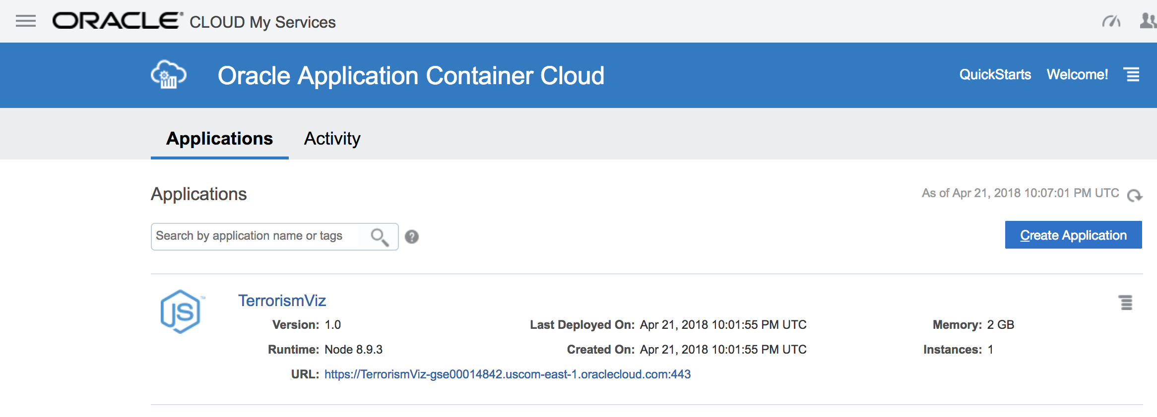
PaaS
https://terrorismviz-gse00014842.uscom-east-1.oraclecloud.com/

Slide 8
IaaS - Oracle Compute
Create Compute instance
Update security list, open to all protocols

Slide 9
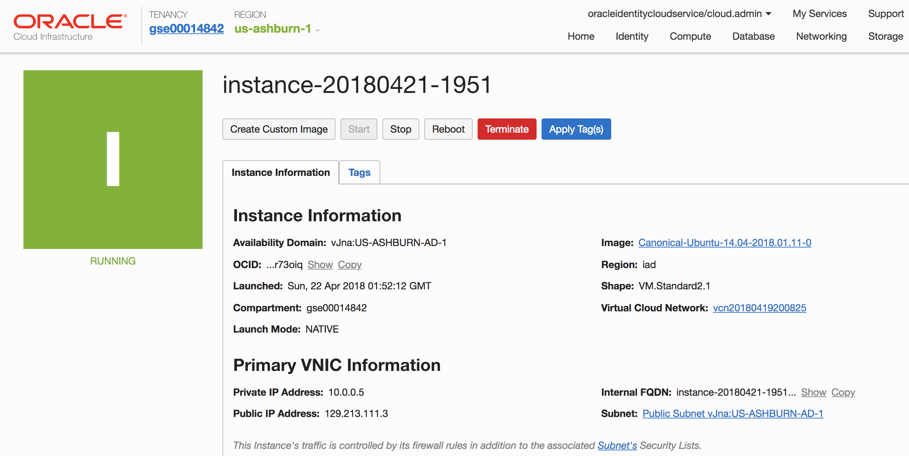
IaaS

Slide 10
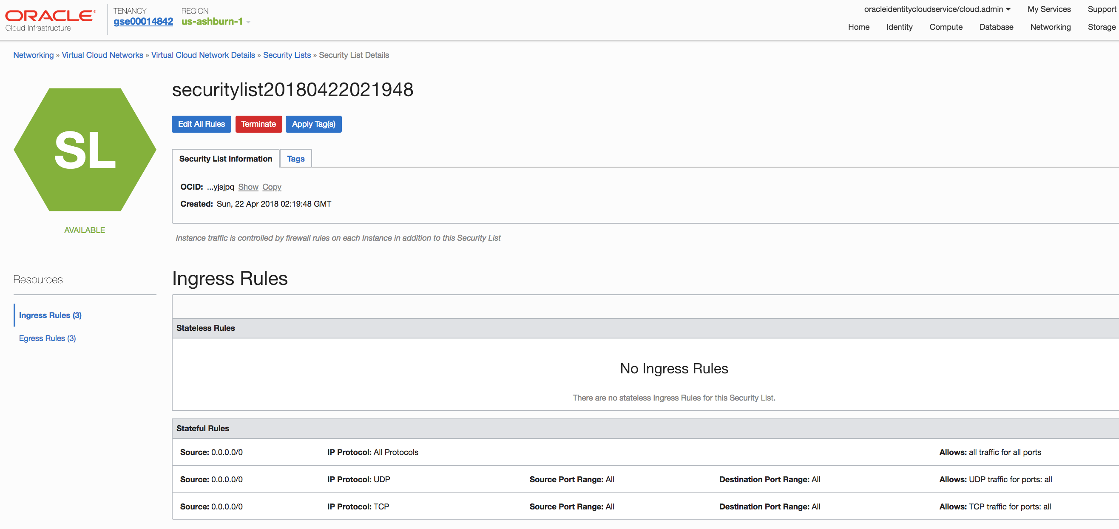
IaaS
129.213.111.3:3000

Slide 11
Benefits
Scalability
Security
Ease of deployment
Notes:
One of the largest benefits of the cloud is the ability to scale. In traditional server hosting, you have to determine the specific hardware that each node of your system would run on from the web/application servers to the database servers. For highly available applications, you need load balancing of web and/or application servers and database clustering that requires expensive SAN (storage-area network) configuration. All of this requires extensive planning and locks you into this general configuration for several years based on setup cost alone.

Slide 12
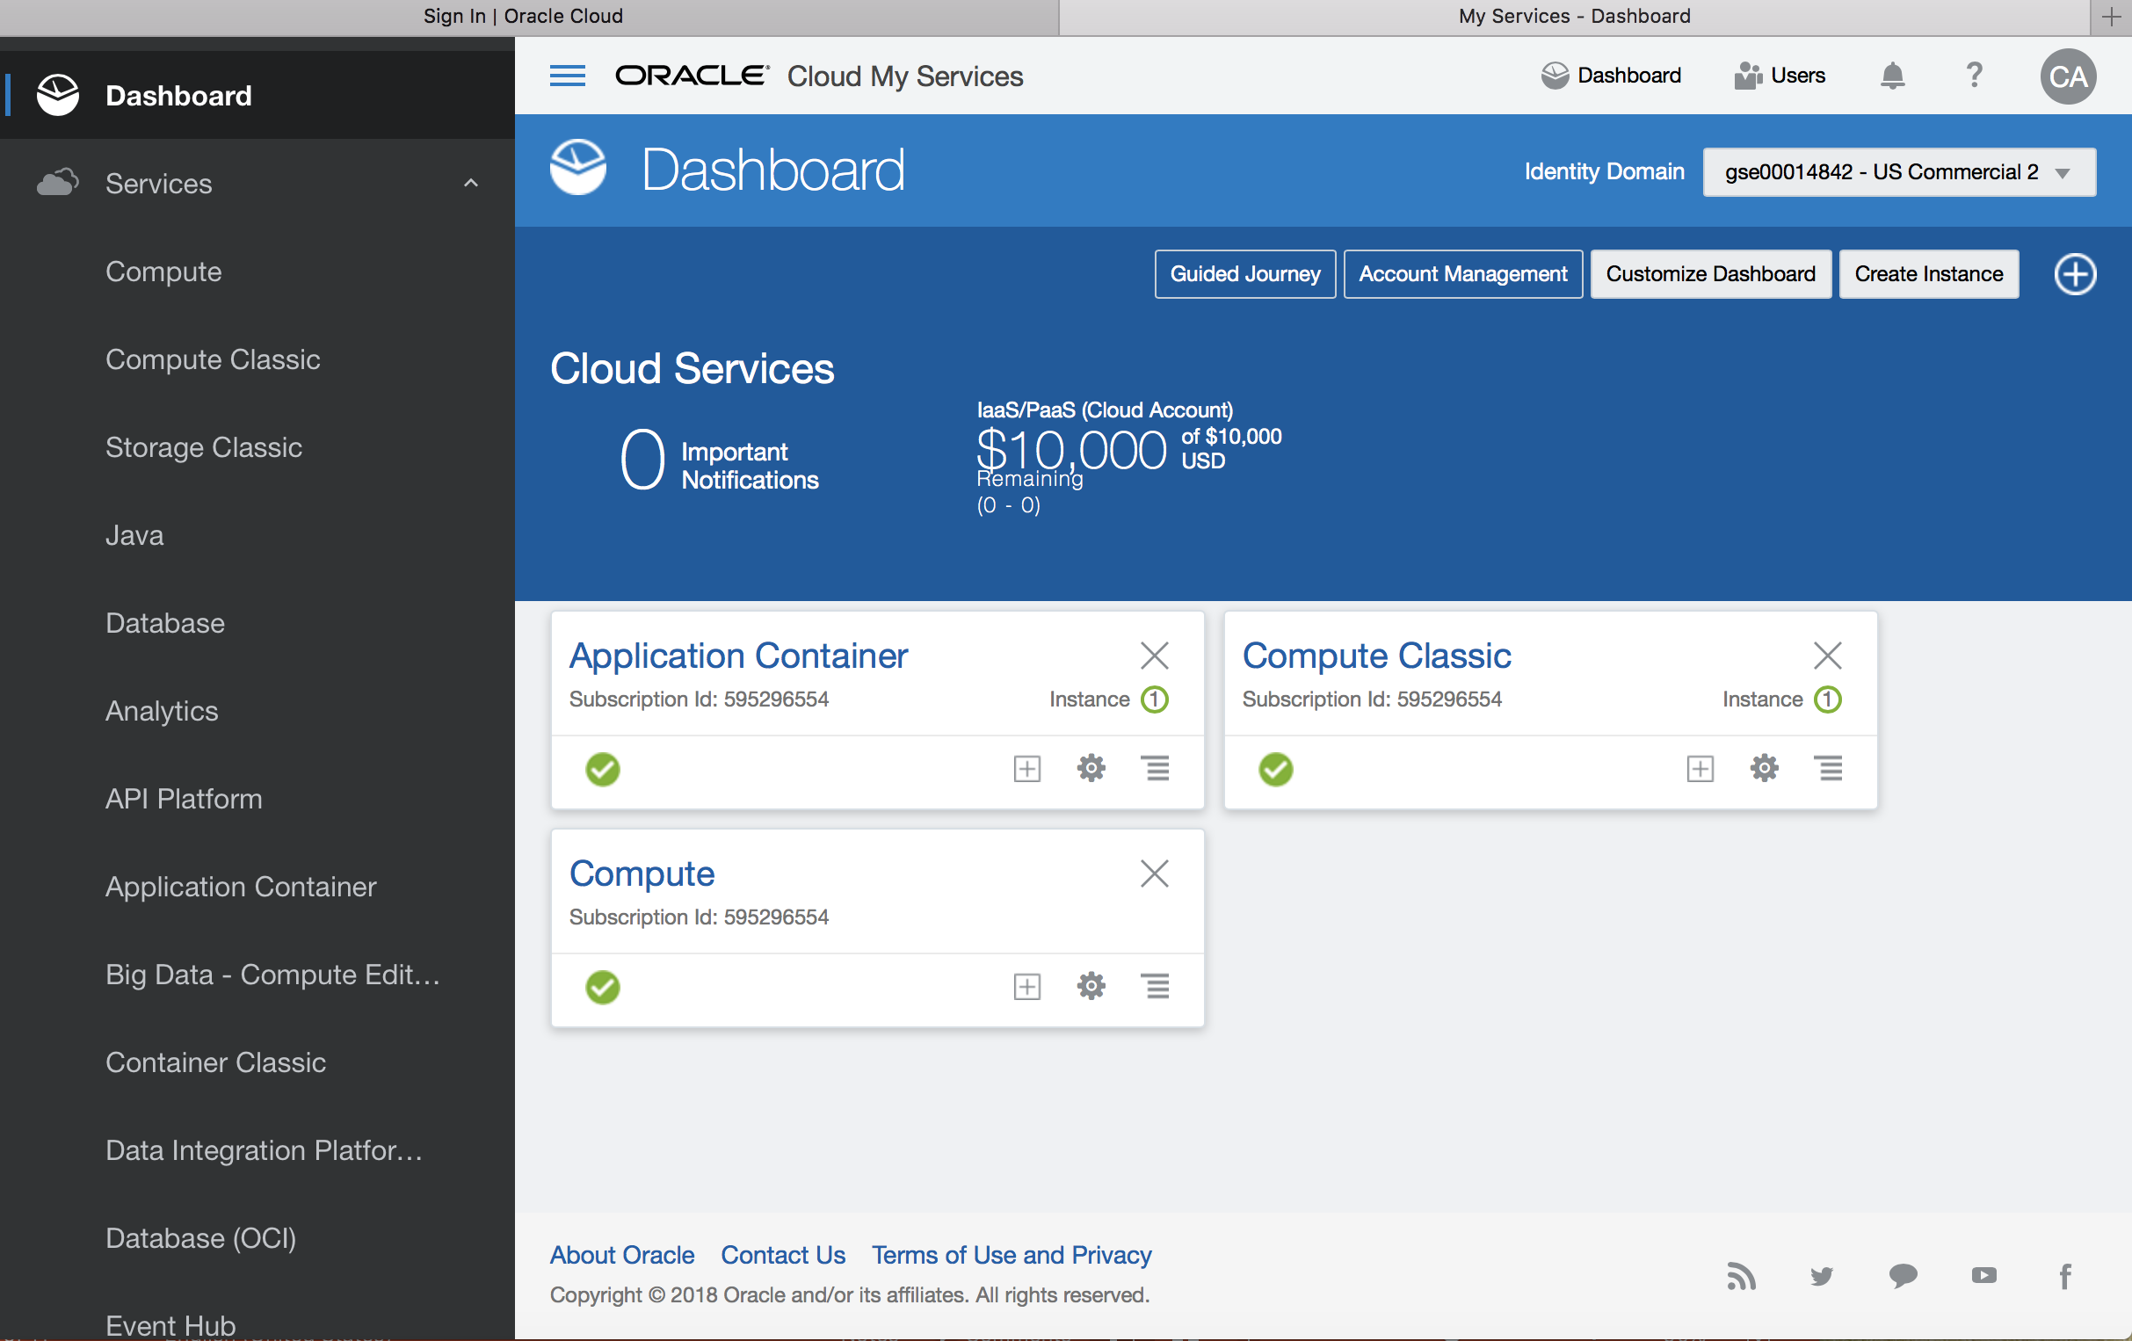
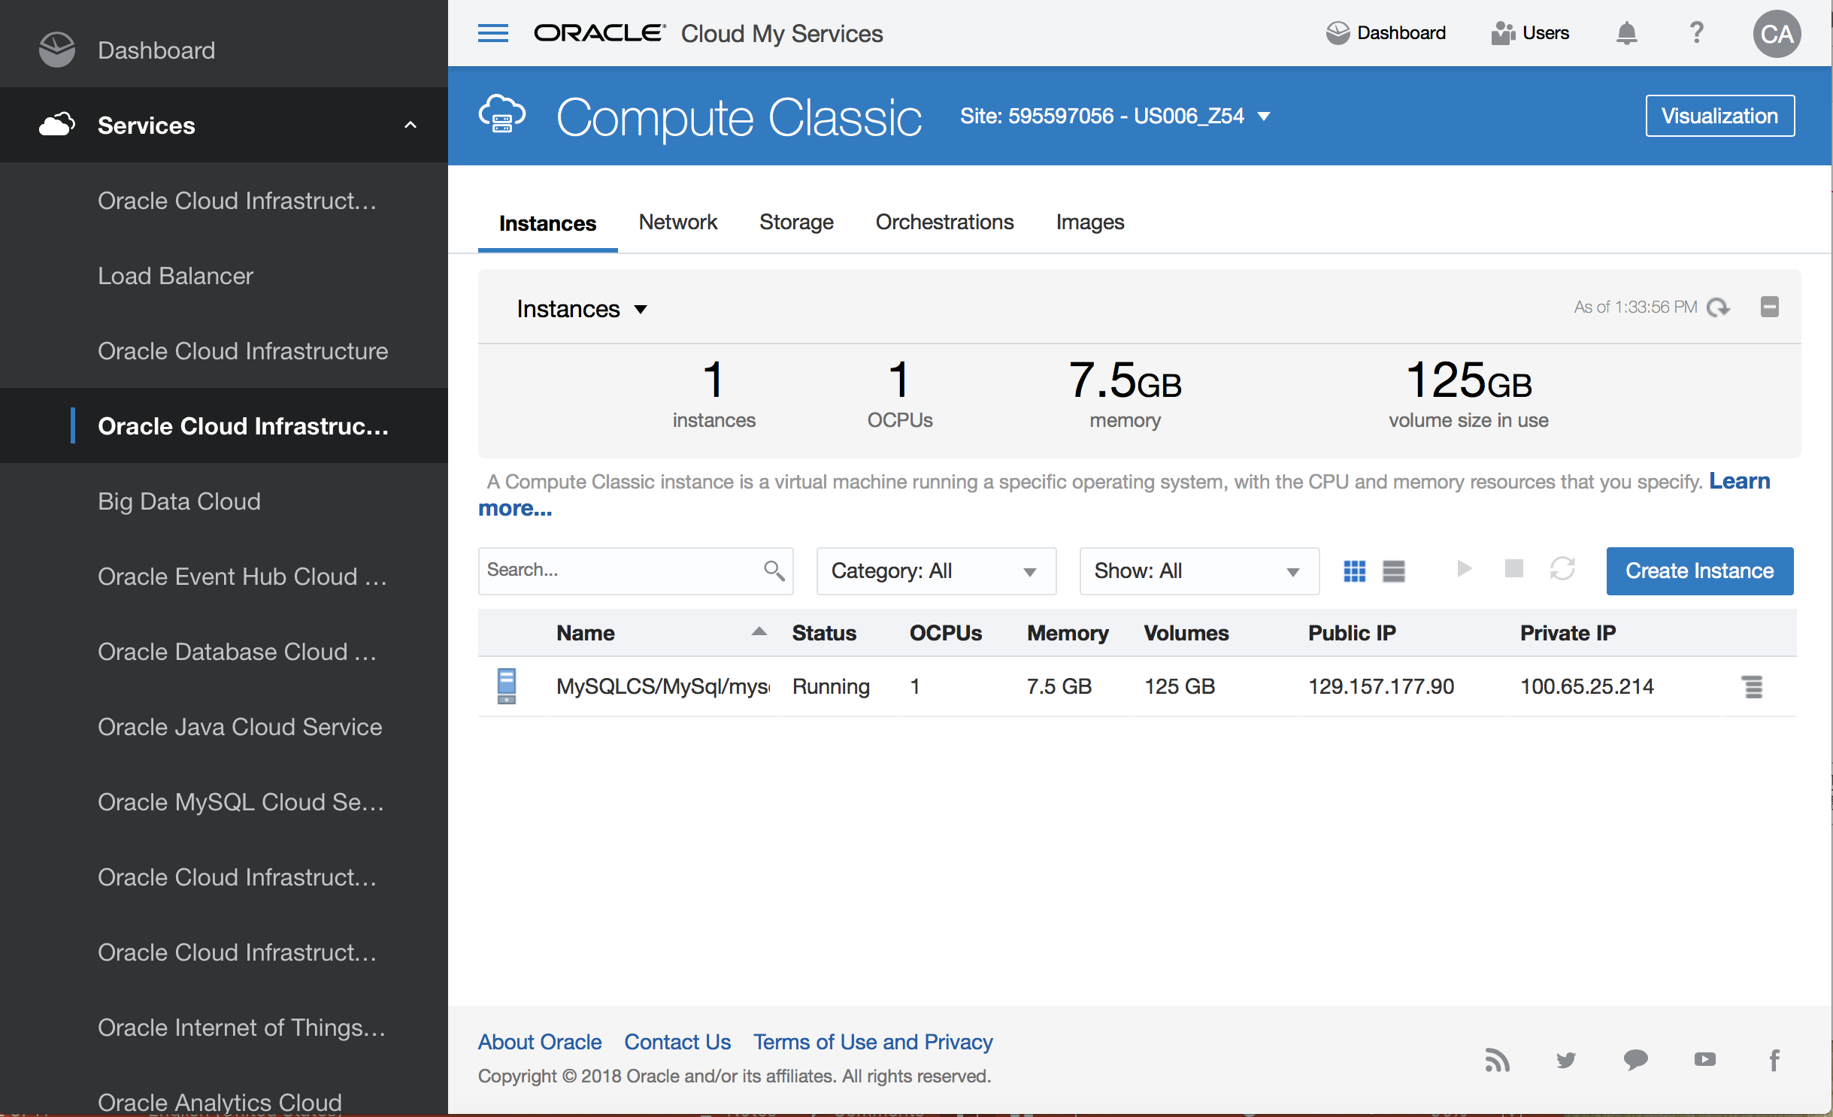
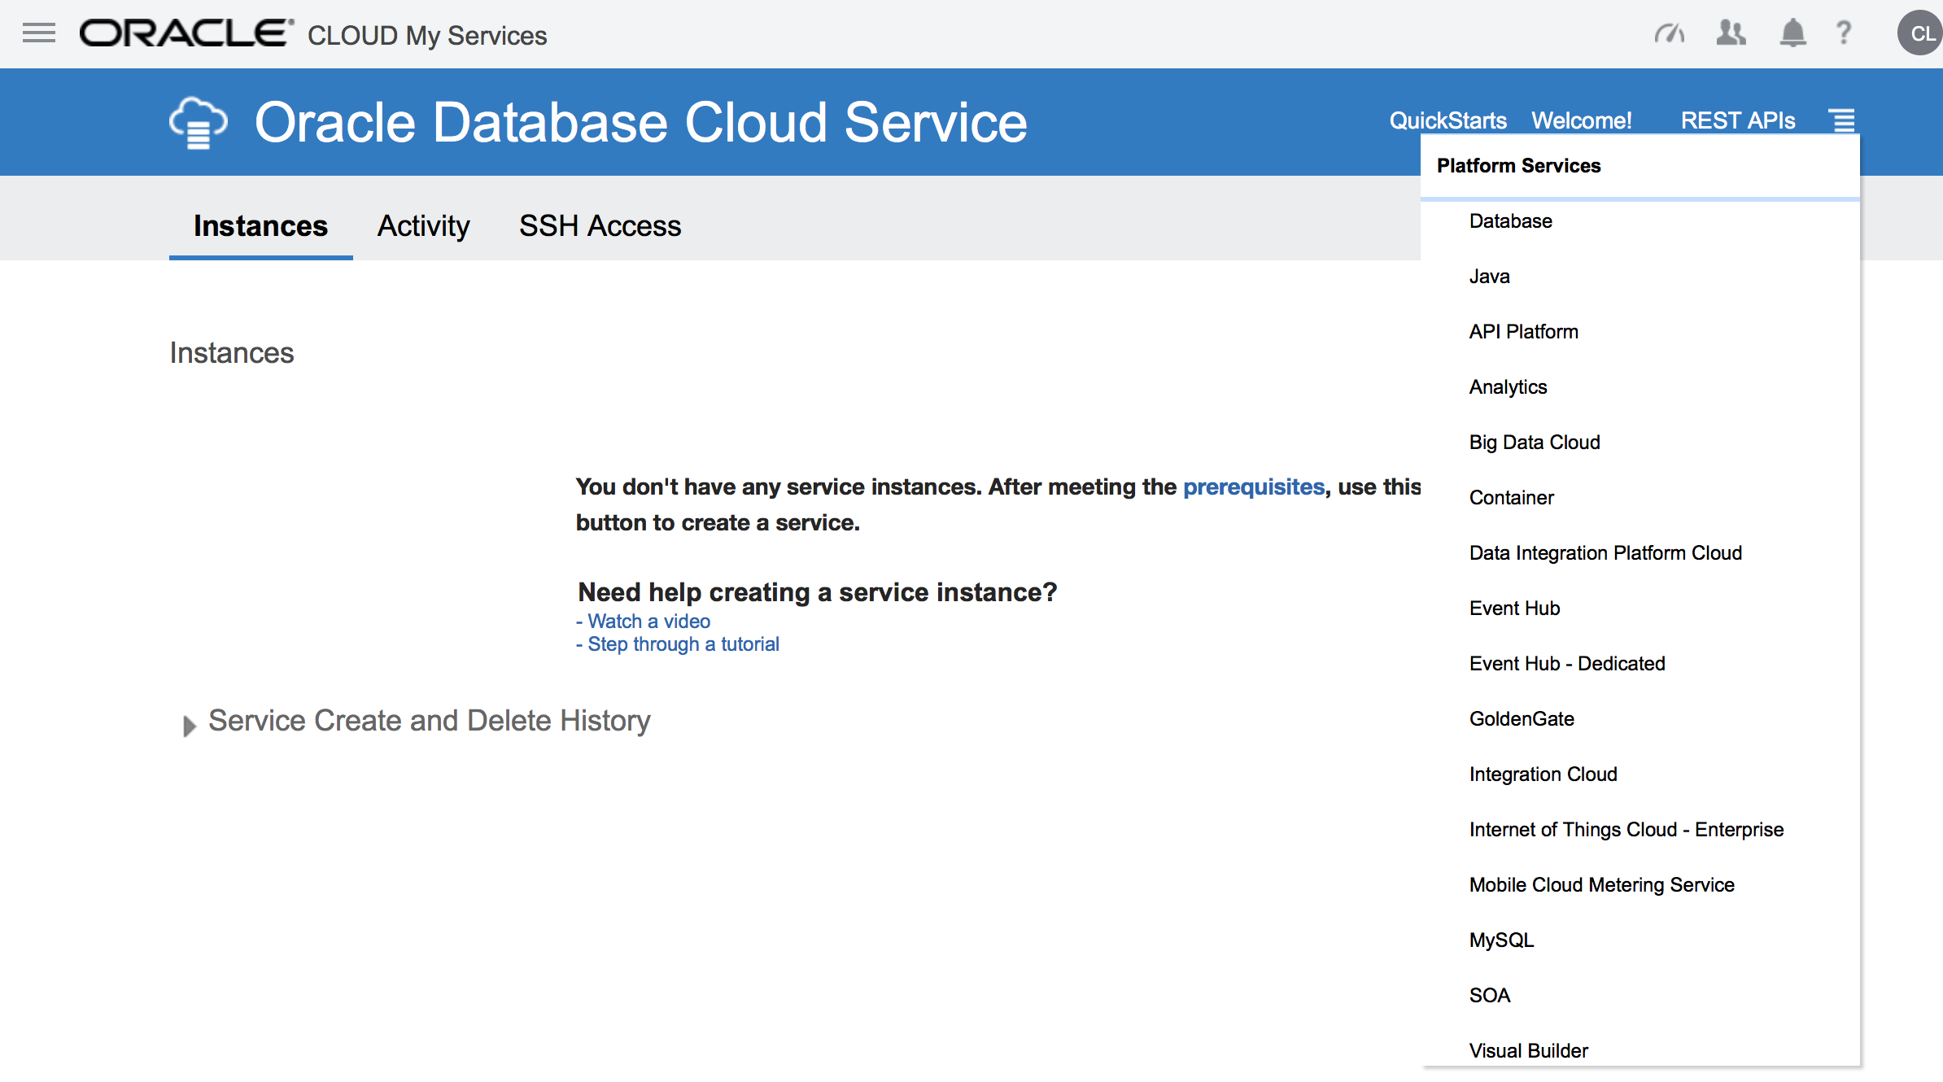
Feedback
The navigation should be consistent
Lack documentation

Slide 13
Xuan Gao
Thanks!

